Slide 1
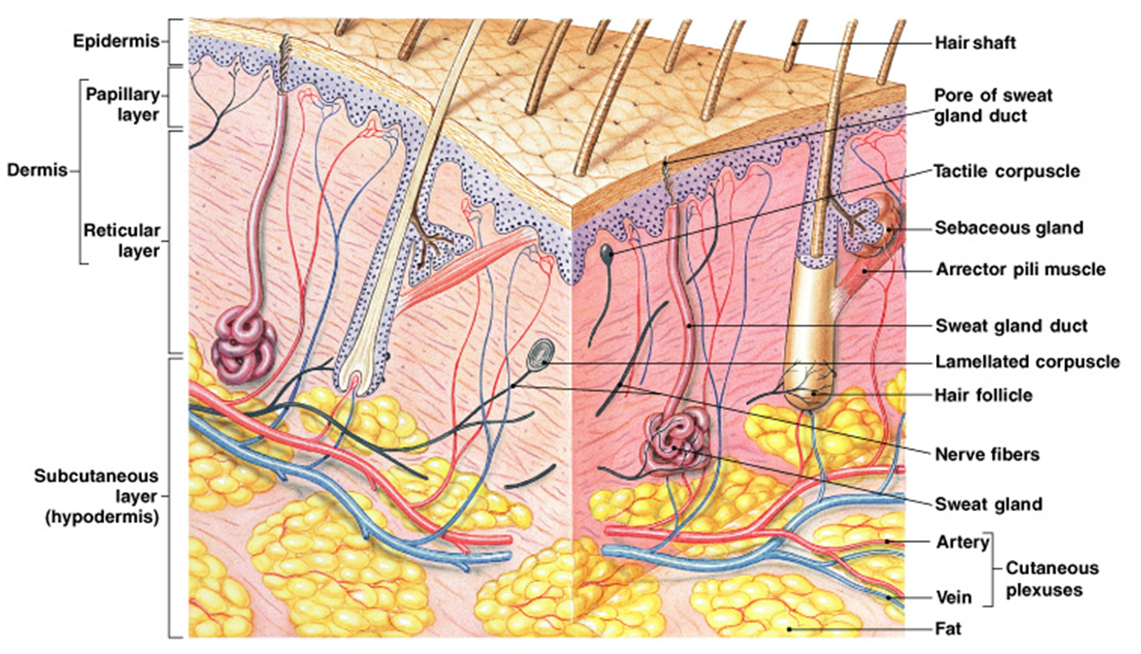
SKIN AND FASCIA

Slide 2
skin :-
Introduction:-
The skin is the largest organ of the body.
It is not uniformly thick.
At some place it is the thick and in some places it is thin.
The average thickness of the skin is about 1-2 mm,
In the sole of the foot, palm of the hand and in the intrascapular region, it is considerably thick, thickness about 5mm.
In other areas of the body the skin is thin.
Eg: Eyelid, pennies, thickness about 0.5mm only.

Slide 3
Function of the skin:-
The primary function of the skin is the protection of organs
Primary function:-
Skin forms the covering of all the organs of the body and protects these organs from following factors.
Bacteria and toxic substance.
Mechanical blow.
Ultraviolet rays.
Protection from bacteria and toxic substances:-
Skin covers the organs of the body and protect organs, these organs covering the skin having direct contact with external environment.
Thus it prevents the bacterial infection.

Slide 4
Protection from mechanical blow:-
The skin is not tightly placed over the underlying organs or tissues.
It some what loose and moves over the underlying subcutaneous tissues.
So mechanical blow to the skin is not transmitted to the underlying tissues.
Protection from ultraviolet rays:-
The skin protects the body from ultraviolet rays of sun light.
Exposure to sun light or to any other source of ultraviolet rays increase the production of melanin pigment in skin.
Melanin absorb the ultraviolet rays.
At the same time the thickness of stratum corneum increases, this layer of epidermis also absorbs the u.v rays.

Slide 5
Synthetic function:-
Skin is the site for synthesis Vitamin D with help of sunlight.
The vitamin D help in the absorption of calcium from intestine
Storage function:-
Skin store fat, water and sugar.
Excreatory function:-
Skin can excrete small quantities of waste material like urea, salts and fatty substance.
Absorptive function:-
Skin can absorb the fat soluble substance and some ointment

Slide 6
Regulation of body temperature:-
The skin regulates body temperature.
When the body is too cold, the skin’s blood vessels constrict.
This allows more heat-carrying blood to circulate to the muscles and organs.
When the body is too hot, the blood vessels in the skin dilate.
That brings more blood to the surface for cooling by radiation.
At the same time, sweat glands secrete more sweat that cools the body when it evaporates

Slide 7
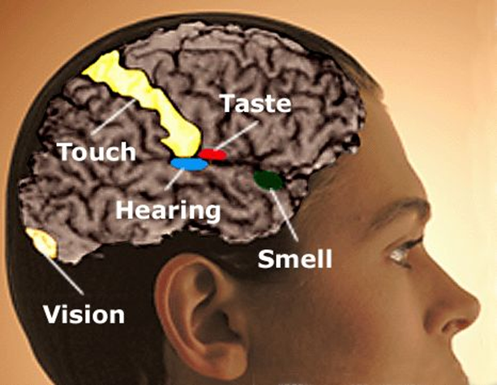
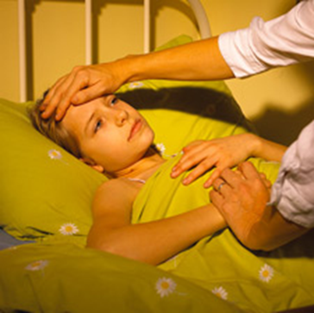
Act as a sense organ
It contains millions of nerve endings that act as sensory receptors for pain, heat, cold, and pressure.
When stimulation occurs, nerve impulses are sent to the cerebral cortex of the brain… and the brain triggers any necessary response.

Slide 8
Structure of Skin:-
Skin is made up of 2 layers..
Outer epidermis.
Inner dermis.
(i). Epidermis:-
It is the outer layer of the skin.
It is formed by stratified epithelium, which consist of 5 layers. They are
Stratum corneum
Stratum lucidum
Stratum granulosum
Stratum spinosum
Stratum germinativum

Slide 9
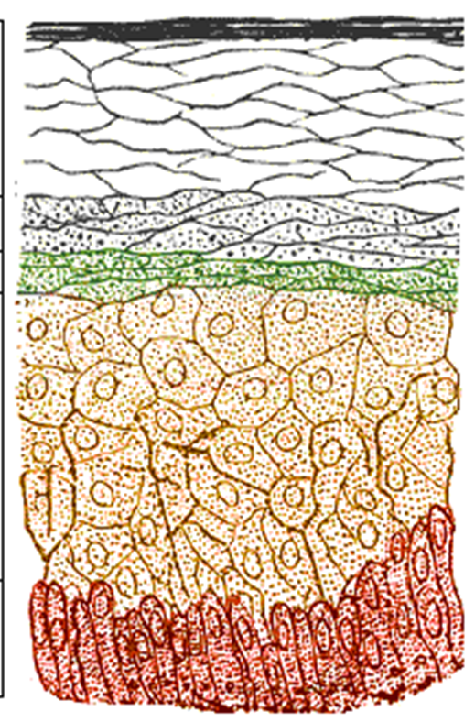
The stratum corneum (STRĂT um KOR nee um)
It is the outermost layer of the epidermis.
It is mostly dead cells because, the cell loose their nucleus because of the pressure.
Cytoplasm flattened with fibrous protein known as keratin.
It is thicker on the soles of the feet than on the eyelids…where there is less pressure.

Slide 10
Stratum lucidum:-
It is made up of flattened epithelial cells.
Many cells have a degenerated nucleus, in some cells the nucleus is absent.
These cell exhibit shiny character, the layer look like a homogeneous translucent zone, so this layer is called stratum lucidum.

Slide 11
Stratum Granulosum:-
It is thin layer with 2-5 rows of flattened rhomboid cells.
The cytoplasm contains granules of protein called keratohyaline.
It is the precursor of keratin.
Stratum spinosum:-
It is also known as Prickle cell layer because the cell of this layer possess some spine like protoplasmic projections.
By theses projection the cells are connected to one another.

Slide 12
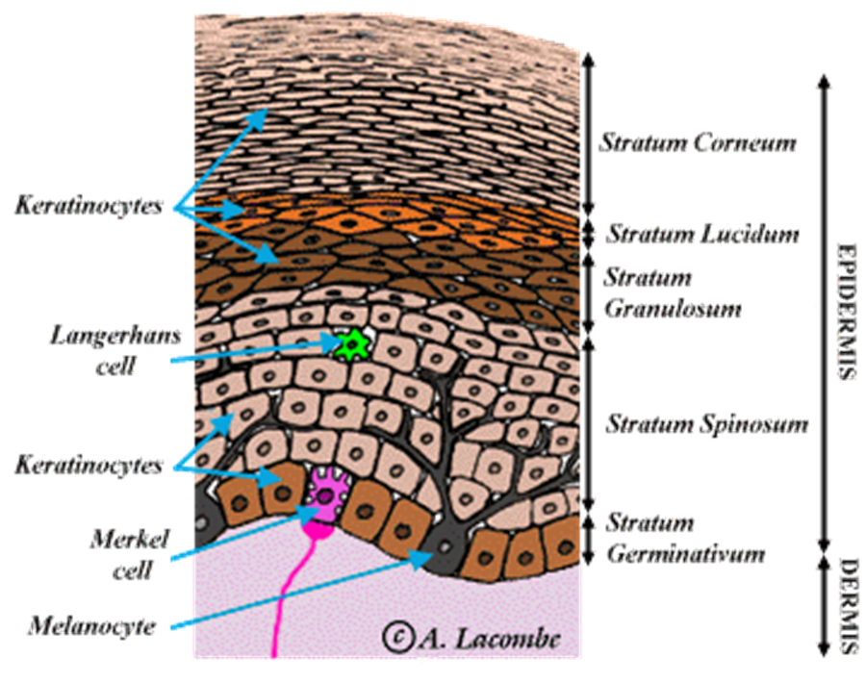
Stratum germinativum:-
It is a thick layer made up of polygonal cells superficially and columnar or cuboidal epithelial cells in the deeper parts.
Here new cells are constantly formed by mitotic division.
The newly formed cells move continuously towards the stratum corneum.
The stem cell which give rise to new cells are known as keratinocytes.
Another type of cells are called melanocytes are scattered between the keratinocytes.
Here melanocytes produce the pigment called melanin.
The color of the skin depends on melanin.
Damage to this layer, such as in severe burns, requires skin grafts.

Slide 13
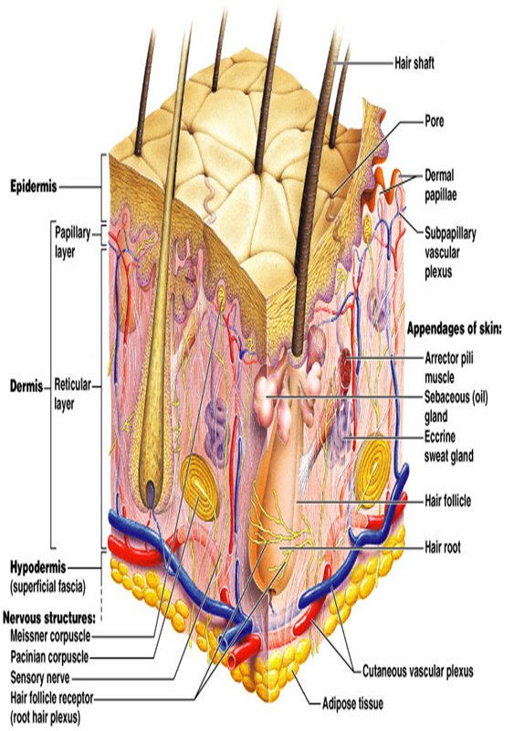
(ii). DERMIS:-
The dermis is beneath the epidermis and is composed of connective tissue.(Dense and stout collagen fibers, fibroblasts and histocytes)
The collagen fibers exhibit elastic property and are capable of storing or holding water.
The collagen fibers contains the enzyme collagenase, which is responsible for the wound healing
It contains the lymphatics, nerves, blood vessels, sebaceous and sweat glands, elastic fibers, and hair follicles.
The dermis is divided into two layers.
Superficial papillary layer.
Deeper reticular layer.

Slide 14
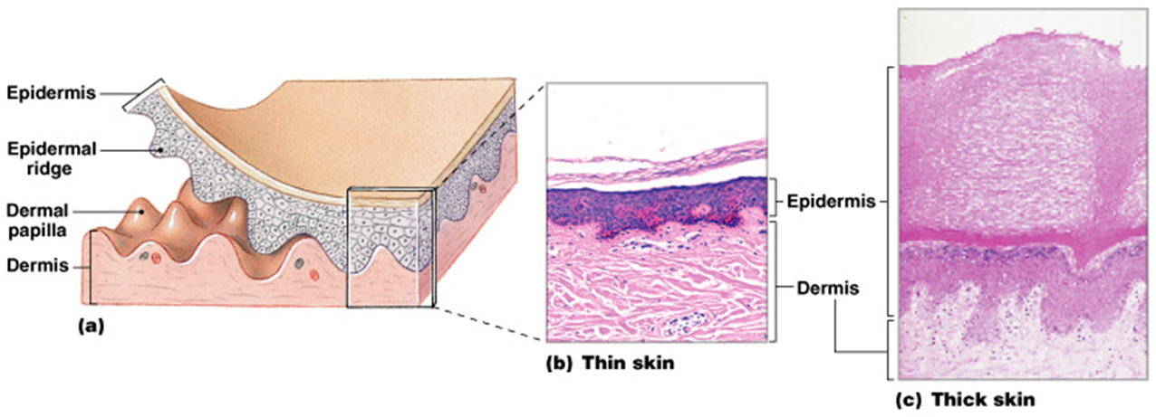
Superficial papillary layer:-
This layer forms about 1/5 of the total thickness of the dermis.
It composed of loose areolar connective tissue with elastic fibers.
It contains blood vessels, lymphatics and nerve fibers.
This layer also has some pigment containing cells known as chromatophore.
This layer sends finger like projections (Dermal papillae) towards the epidermis.
Each papilla contains capillaries and sensory nerve endings,and are well developed in thick skin.

Slide 15
Deep reticular layer:-
It is made up of reticular and elastic fibers.
These fibers are found around the hair bulb, sweat glands and sebaceous gland.
The reticular layer also contains nerve endings, lymphatic's, and fibroblasts.
Immediately below the dermis, subcutaneous tissue is present, It is loose connective tissue,(Areolar and adipose tissue)

Slide 16
Type of Skin:-
The skin is present two types they are.
Thin hairy skin
Thick hair less skin
Thin hairy skin:-
It is present all over the body except for palms and soles.
Epidermis is thin.
This kind of skin is hairy.
Thick hairless skin:-
Which is present in the palms, soles.
Hair also absent in the nipples, lips, glans of penis, glans of clitoris, labia minora and inner surface of labia majora.

Slide 17
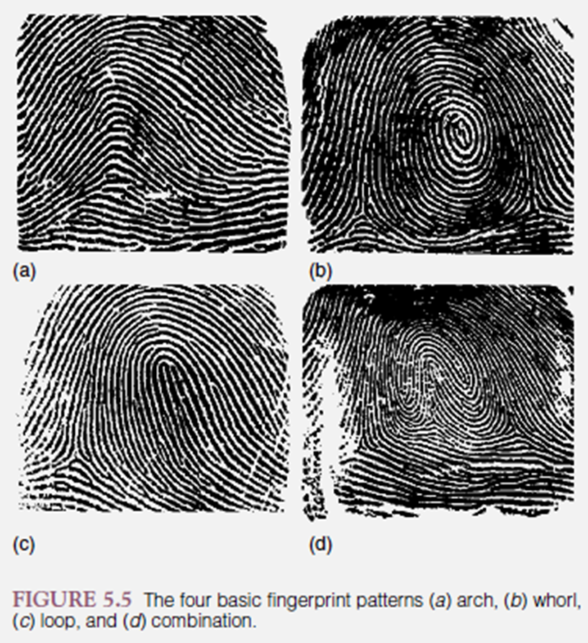
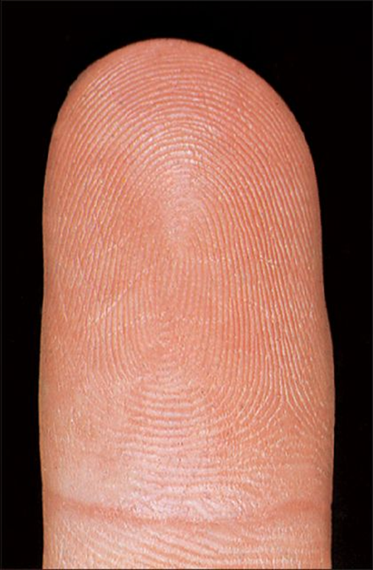
Thick skin-
It is present in the palms, palmar surface of the fingers and sole.
It is hairless but contains lot of sweat glands.
Here the epidermis is relatively thick.
The surface of thick skin on palms and soles in not smooth, but show the presence of narrow ridges known as epidermal ridges (Fingerprint)
Epidermal ridges may be in the forms of pattern like whorl, loop, arch, triradi (combination)
The epidermal ridges (fingerprints) helpful in identification of Person.
Fingerprints are taken from the site of crime to detect the criminals.
The analysis of ridge patterns by studying finger and foot prints is known as dermatoglyphics.

Slide 18
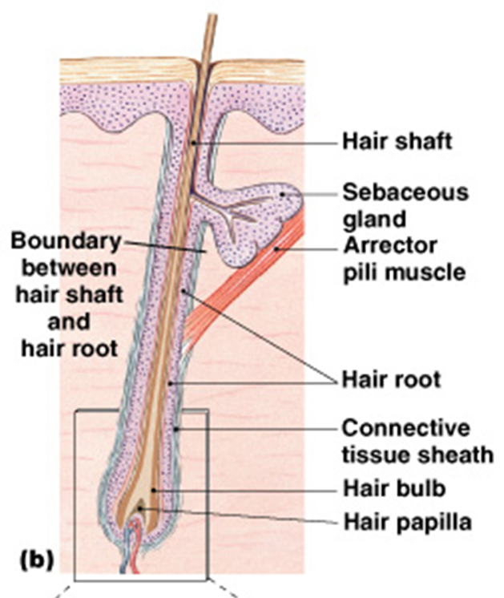
HAIR
Hair are present on thin skin but absent on thick skin (palm and sole).
Hair grows densely on scalp, eyebrows and around external genitalia.
Beard and moustaches grows only in males after puberty.
The base of hair follicle is called as bulb.
Bulb enclosing a loop of capillaries.
It is called the hair papilla.
Provides nourishment to the hair.

Slide 19
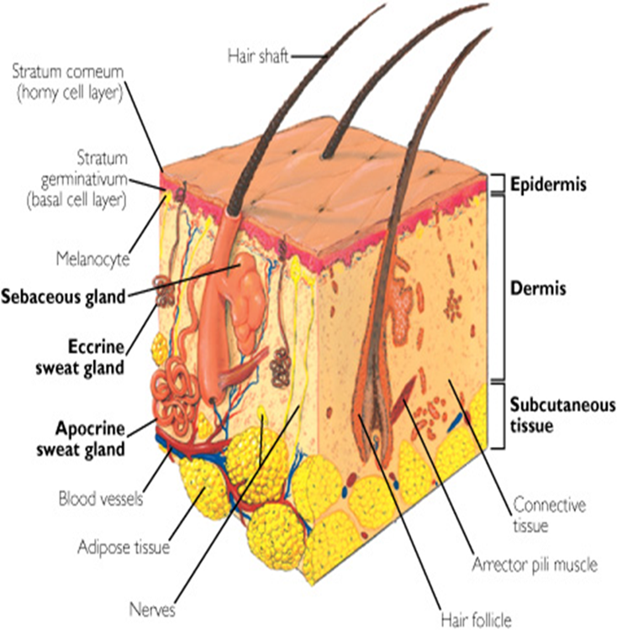
Part of Hair
A single hair has a shaft which projects above the surface of the skin.
Root which is enclosed by hair follicle is present in the dermis
The hair follicle is a tubular invagination that is partly epidermal and partly dermal in origin .
The shaft and the root of a hair consist of epidermal cells that are keratinized.
These cells are arranged in three concentric layers.
Medulla
Cortex
Cuticle.

Slide 20
Cuticle
The transparent cuticle covers the hair shaft like a roof.
Protecting it from the elements and chemicals, and from losing moisture.
The cortex
It provides most of the hair’s weight.
It contains melanin which provides color to the hair, stores oils, provides flexibility and elasticity, and adds shape to the hair.
When the cuticle is damaged hair looks dull and dry.
The medulla
It is a inner hollow core that runs the length of the shaft.

Slide 21
The hair follicle is associated with sebaceous glands and a bundle of smooth muscles cells called as arrector pilli.
The arrector pilli connects the hair follicle to the superficial layer of dermis.
When arrector muscle contract it pull the hair shaft perpendicular to the skin.

Slide 22
NAIL
Nails are plates of modified hard, keratinized epidermnal cells.
Each nail consists of nail plate and nail bed.
Nail plate
It is a part of nail, which consists of nail edge, body of nail and a hidden part of the nail root.
In the nail plate the keratinized cells are tightly packed and become very hard due to the formation of hard keratin.
Nail bed
Nail bed consists of epidermis and dermis.
The epithelium deep to nail root is called as nail matrix.
The nail matrix is involved in the growth of nail.
The average growth in the length of finger nail is about 1mm per week.

Slide 23
Glands of the Skin:-
Skin contain two types of glands, They are Sebaceous gland and Sweat gland.
Sebaceous gland:-
Structure :-
These glands are ovoid or spherical in shape and are situated at the side of the hair follicle.
Sebaceous glands are absent in thick skin.
Which is devoid of hair follicles.
Each gland is covered by connective tissues.
Acne vulgaries (pimples) is the common inflammation of sebaceous glands at the age of puberty.
Function:-
It produce the sebum , it is anti bacterial and anti fungal.
It prevents the infection of skin by bacteria or fungi

Slide 24
Sweat glands:-
The sweat glands secrete watery secretion (sweat) on the surface of the skin through sweat pores.
These glands are present all over the skin and are estimated to be about 3 to 4 million sweat glands all over the body.
They may secrete few liters of sweat per day during summer season.
Secretion reduces to about ½ to 1 liter per day during winter season.
Sweat glands are of two types Eccrine and Apocrine.

Slide 25
Eccrine sweat glands
Apocrine sweat glands
These glands are widely distributed throughout the skin except lips, glans penis, labia minora
These glands are simply coiled tubular gland.
The ducts of glands open through pores on the surface of the skin.
These glands are found in the skin of axilla, groin, areola of breast ,labia minora, scrotum, peri-anal region.
These are also simple coiled tubular glands.
The ducts of apocrine glands open in the apical part of hair follicles.

Slide 27
Ceruminous glands
Ceruminous glands are modified apocrine sweat glands.
These glands are present in the external acoustic meatus(external ear canal) and produce a waxy secretion.
This secretion is called as cerumen, which along with hair of ear canal provides a sticky barrier for foreign bodies.
Mammary Glands
Mammary glands are specialized sweat glands that secrete milk in female.
These glands are located in the subcutancous layer.

Slide 28
FASCIA

Slide 29
Fascia is the collection of connective tissue.
The deep structure of body ,i.e ; muscles and bones are separated from skin by two layers of connective tissue ,the superficial and deep fascia.
The superficial fascia is made up of loose areolar tissue
Deep fascia is made up of dense , inelastic membrane.
Superficial fascia:-
This is the general coating of the body beneath the skin made up of lose areolar tissue with varying amount of fat.
Distribution of fat in this fascia:-
Fat is abundant in the gluteal region (buttocks), lumbar region, front of the thigh, anterior abdominal wall.
In female fat is more abundant and is more evenly distributed than male.
Fat is absent from the eyelid, external ear, penis and scrotum.

Slide 30
Types of fat:-
There are two type of fat yellow and brown fat.
Most of the body fat is yellow only in hibernating animals it is brown.
Characteristic features of the superficial fascia:-
It is mostly present in the lower part of the anterior abdominal wall, perineum and the limb.
It is very thin on the dorsal aspects of the hands and feet, sides of the neck, face and around the anus.
It is very dense in the scalp, palms and soles.
Function:-
Superficial fascia facilitates movement of the skin.
It serves as a soft medium for the passage of the vessels and nerve to the skin.
It conserves body heat because fat is a bad conductor of heat.

Slide 31
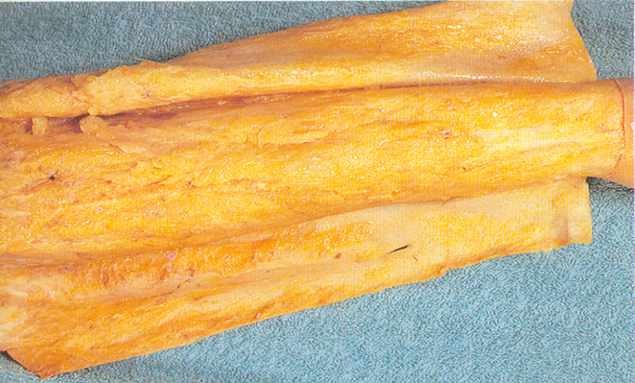

Slide 32
DEEP FASCIA
The deep fascia covers almost whole body except face.
Through it is not very well developed in thorax and abdomen but it is well defined in upper limbs, lower limbs and neck.
In neck it is present in three layers
1) Investing layer,
2) pre-tracheal fascia.
3) Prevertebral fascia.
The deep fascia is a dense inelastic connective tissue membrane.
Which is present beneath the superficial fascia and covers the deeper structures.
Deep fascia helps to maintains the shape and position of muscles.

Slide 33
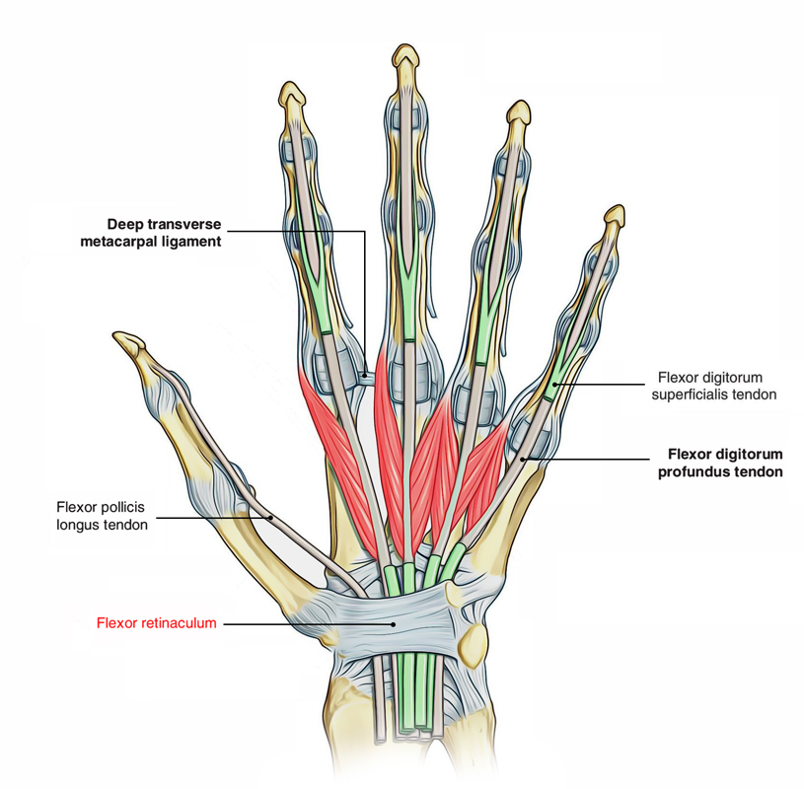
Modification of deep fascia
Intermuscular Septa
The septa are present between the group of muscles
These septa are called intermuscular septa that help to from compartments of muscles.
B. Retinaculum and Fibrous Flexor Sheath
At various places in body ,when tendons pass close to a joint ,deep fascia becomes transversely thickened to form retinaculum or retention band.
Examples flexor and extensor retinaculum are present around the wrist and the ankle joint.

Slide 34
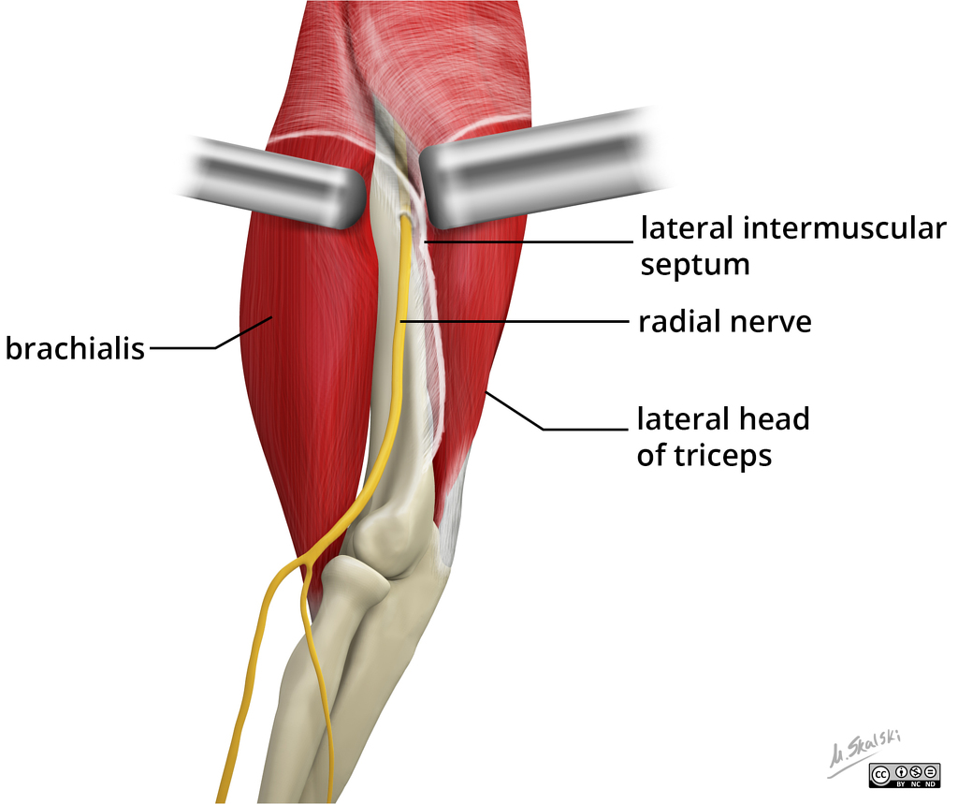

Slide 35
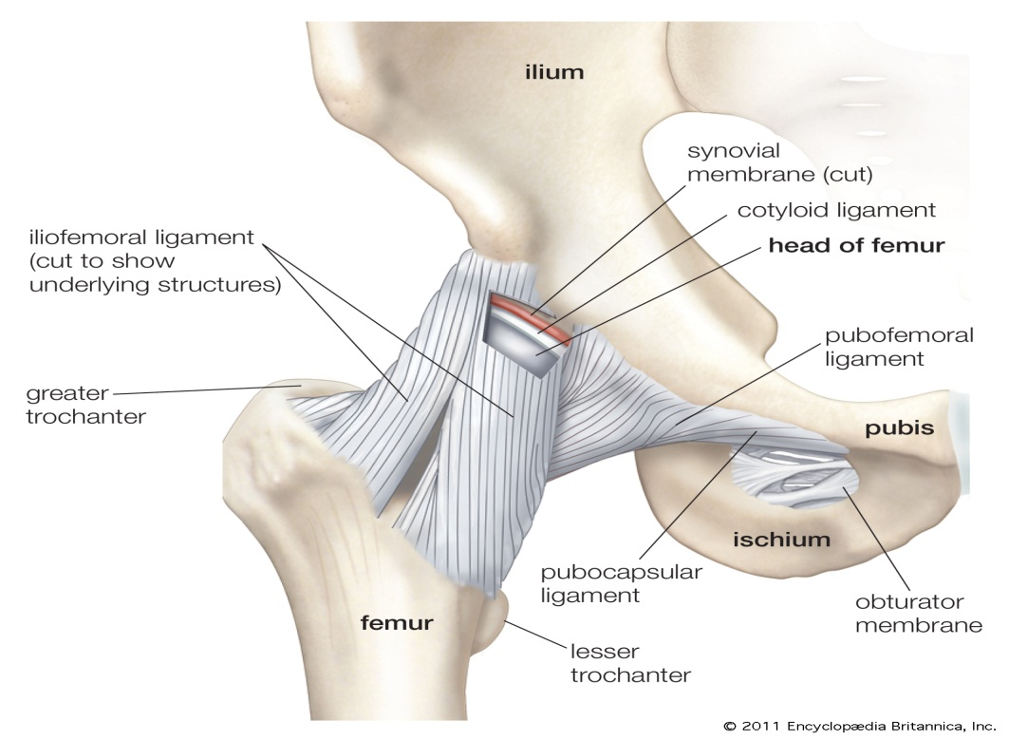
Aponeurosis
An aponeurosis is also a localized thickening of deep fascia.
Whenever a muscle is attached to the bone,the deep fascia acts like an aponeurotic tissue.
Here the deep fascia receives the pull of muscles and transmit it to the bone.
Ligament
Ligaments are considered as thickening of deep fascia, which connect bones at joints

Slide 36
Function of deep fascia:-
Deep fascia keeps the underlying structures in position and preserves the characteristic surface shape of the limbs.
It provides extra surface for muscular attachments
It helps in venous and lymphatic return.
It assist muscles in their action by the degree of tension and pressure it exerts upon their surface.

Slide 37
APPLIED ANATOMY

Slide 38
Albinism:
When there is failure of production of melanin pigment the skin, hair and eyes are white.
This condition is called as albinism.
In the condition ,even if melanocytes are present, they are unable to produce melanin due to the absence of enzyme tyrosinase.
Vitiligo:
In this condition there is partial or complete loss of melanocytes from skin patches.
This produces irregular white spot on the skin.

Slide 39
Abnormal Colour of skin
Skin may exhibit abnormal color of diagnostic value:
Cyanosis:
The blueness of the skin which results due to deficiency of oxygen in circulating blood.
The O2 deficiency turns the haemoglobin a reddish violet colour.
Erythema:
It is abnormal redness of skin .
It is caused due to increased blood flow in dilated cutaneous blood vessels .
It occurs in hot weather, sunburn, anger, embarrassment.

Slide 40
Jaundice:
It is yellow of skin resulting from high level of bilirubin in the blood.
Bilirubin is a haemoglobin breakdown product.
Bilirubin can accumulate in skin to discolour the skin.
Sebaceous cyst is common in the scalp.
It is due to obstruction of the mouth of a sebaceous duct caused either by trauma or infection.
The common skin diseases are fungal (like ring worm), allergic and parasitic. The usual complaints pertaining to skin are itching and burning

Slide 41
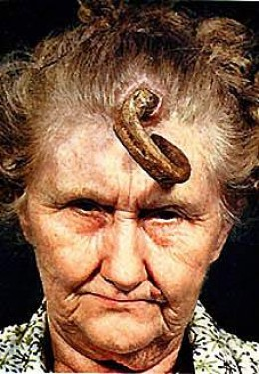
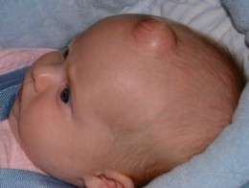

Slide 42
